Slide 1
Catt Hall
Ashley Steen
Professor Brenna Dixon
English 150
March 22, 2017

Slide 2
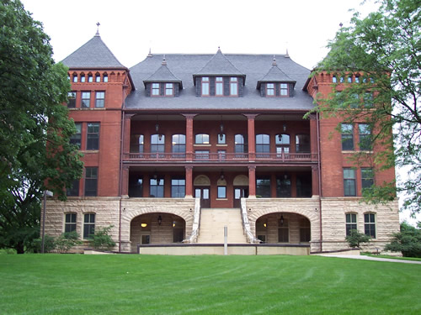
Outline
Catt Hall brief history
Plaza of Heroines
Carrie Chapman
What could you contribute to ISU?
Conclusion
Works cited

Slide 3
Catt Hall
Catt Hall was built on 1892 by Josselyn and Taylor
Formerly named Agricultural Hall.
Four stories with a basement, originally for the Horiculture department.
In 1995, it was dedicated to Carrie Chapman Catt

Slide 4
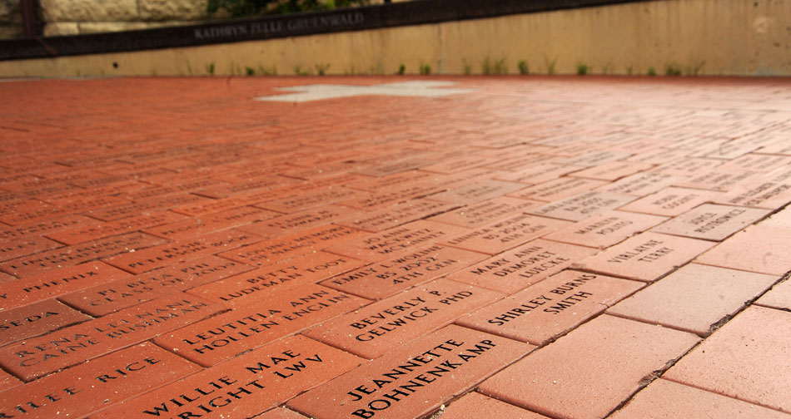
Plaza of Heroines
The plaza of heroines was dedicated in 1995 to honor Carrie Chapman and other known women that have made an impact in our society.
More than 3,600 women
Every year, new bricks are added
(Iowa State University, 1995-2017)

Slide 5
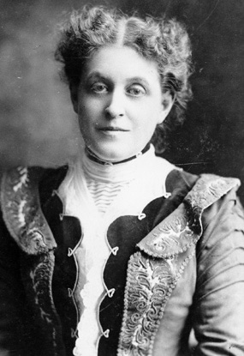
Carrie Chapman
Carrie Chapman Catt was born on January 9, 1859 in Ripon, Wisconsin.
She began working for the National American Woman Suffrage Association, after graduating ISU.
In 1902, Catt helped organize the International Woman Suffrage Alliance (IWSA), which eventually incorporated associations in 32 nations.
In 1917, New York passed a state woman suffrage referendum. Under Carrie’s help she achieved for the Nineteenth Amendment on August 26, 1920.
(Bryn Mawr College Library, 2003)

Slide 6
What could you contribute?
Iowa State gives all students the opportunity to create their own club about whatever they’re passionate about
Use these resources!
If you’re passionate about something, whether it’s women’s rights or anything else
http://www.sac.iastate.edu/student-organizations/starting-a-new-organization/

Slide 7
Conclusion
The Catt Hall is a representation of women’s rights across the United States but most importantly to the suffragist movement.
The Catt Hall is important because it gives history to ISU and an importance to women’s rights.
Whether it’s a rights activist, a famous speaker or even a family member you feel deserves to be honored.

Slide 8
Works Cited
“Suffragette's Racial Remark Haunts College.” The New York Times, The New York Times,
4 May 1996, www.nytimes.com/1996/05/05/us/suffragette-s-racial-remark-haunts-college.html. Accessed 6 Mar. 2017.
“Carrie Chapman Catt Girlhood Home and Museum: About Carrie Chapman Catt.” Carrie
Chapman Catt Girlhood Home and Museum: About Carrie Chapman Catt, www.catt.org/ccabout.html. Accessed 6 Mar. 2017
Reis, Andrea, and Jill Osweiler Schaefer. “History of Campus Buildings at Iowa State
University Catt Hall.” Edited by Michele Christian, History of Campus Buildings at Iowa State University - Catt Hall, www.add.lib.iastate.edu/spcl/exhibits/buildings/catt.html. Accessed 27 Feb. 2017
“Building Information: Catt Hall.” Iowa State University,
www.fpm.iastate.edu/maps/buildings/building.asp?id=21. Accessed 6 Mar. 2017.

