Slide 1
Chupacabra:
The Hispanic Vampire
Ashley Steen

Slide 2
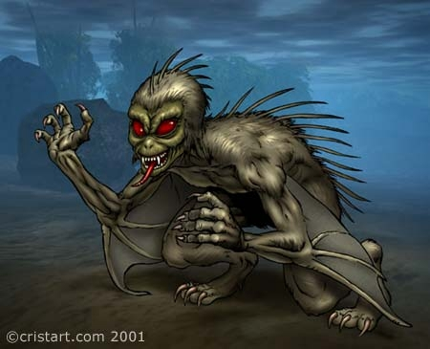
What is a Chupacabra?
A Chupacabra is translated from spanish to “goat-sucker”
The Chupacabra was described as “an upright creature with sharp claws and a row of spikes down it’s back” (Encyclopedia of Urban Legends)

Slide 3
Puerto Rico’s Chupacabra
Madelyn Tolentino described a creature completely different
It resembled a movie
Many animals were found dead without blood

Slide 4
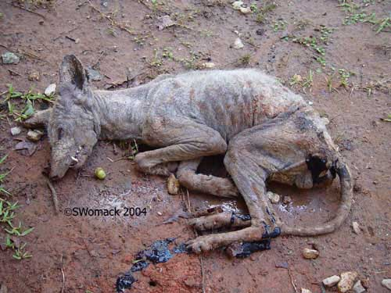
Chile’s Chupacabra
Many were questioning if the Chupacabra was real and others were firm believers
Limari took national guards and armed soldiers
Many speculating whether it was actually a pack of coyotes with an infectious parasite called Sarcoptes scaibei

Slide 5
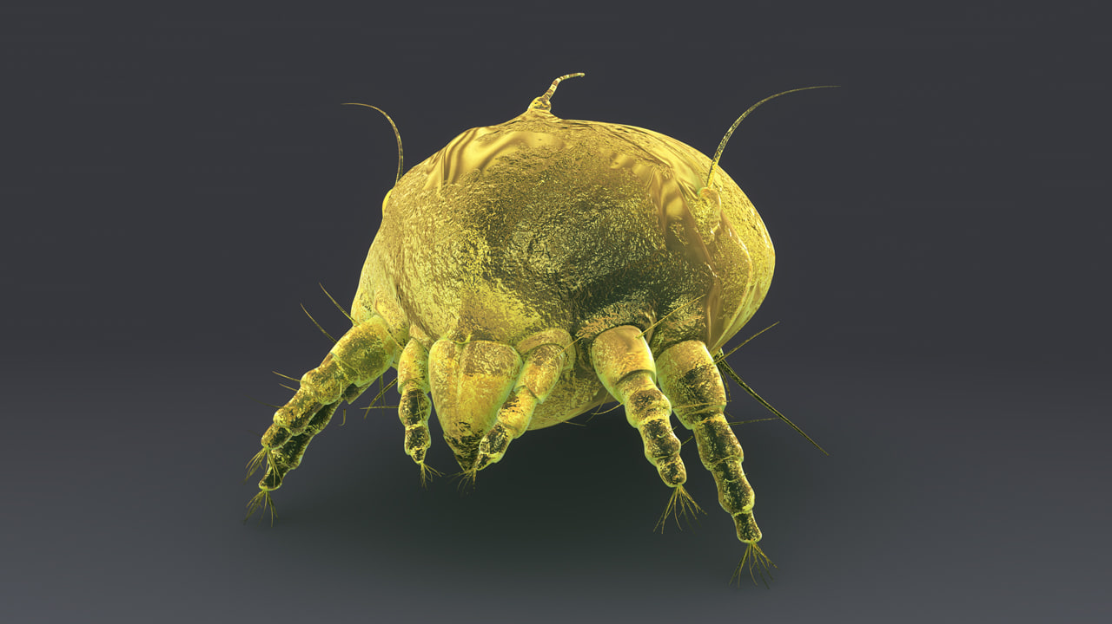
What is the Chupacabra now?
They were infected with a parasite called Sarcoptes scabiei
the parasite causes the animals, in this case coyotes, to look diseased
Since they were having a hard time catching their normal prey, they chose livestock, because it's easier for them to eat

Slide 6
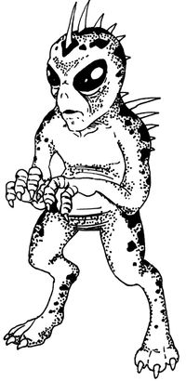
What makes it monstruous?
People’s inability to be able to categorize the “monster” or “thing” into a sort of animal scared people
The type of terror that Stephen King describes as Horror
The feeling of something unnatural

Slide 7
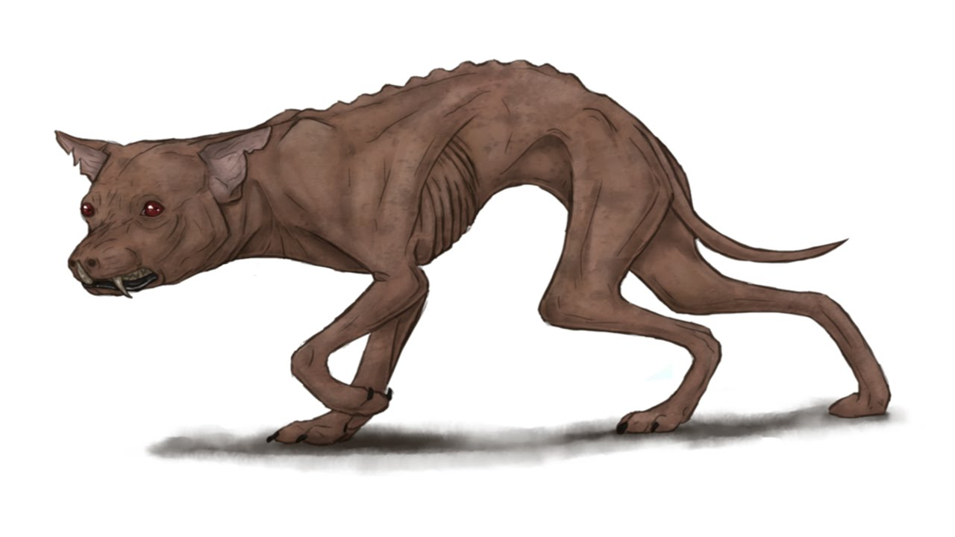
Conclusion
The Chupacabra was considered a “monster” because of its unusual appearance and the way it killed other animals
It’s now a myth but is a good example as to how uncertainty shapes people’s ideas of what a monster is

Slide 8
Works Cited
“NASA Experiments Gone Wrong?” Animal Planet, 13 Aug. 2012,
www.animalplanet.com/tv-shows/lost-tapes/creatures/nasa-experiments-gone-wrong/.
"Chupacabra." Encyclopedia of Urban Legends, Jan Harold Brunvand, ABC-CLIO, 2nd edition, 2012. Credo Reference,
http://proxy.lib.iastate.edu/login?url=http://search.credoreference.com/content/entry/abcul/chupacabra/0?institutionId=1110. Accessed 06
Nov 2017.
https://repeatingislands.files.wordpress.com/2010/07/chupacabra.jpg
https://i2.wp.com/www.sciencebuzz.org/sites/default/files/images/Chupacabra%20small.jpg
http://www.cactushugs.com/wp-content/uploads/2017/07/chupacabra.jpg http://www.mccrecords.com/Chupa-cristart.com2.jpg https://vignette4.wikia.nocookie.net/cryptidz/images/7/76/Rawr_chupacabra_by_rasec_wizzlbang-d5ebf18.png/revision/latest?cb=20150805053703 http://www.prisonbreakfreak.com/wp-content/uploads/2010/08/chupacabra_2.jpg https://vignette.wikia.nocookie.net/aliens/images/0/02/Chupacabra4.jpg/revision/latest/scale-to-width-down/200?cb=20100211060204

