Slide 1
Welcome to UWP 7M!
Please take a few minutes to answer the questions in the student information assignment on Canvas
Notes:
Materials Checklist:
Copies of course syllabus and calendar
Copies of Diagnostic prompt
Copies of Student Information Sheet
Copies of Grammar Test Definitions for the Grammar Diagnostic Quiz

Slide 2
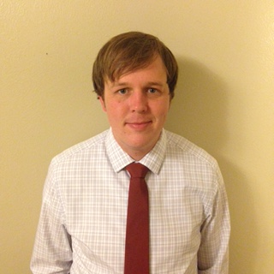
Meet your Teacher: Chris Nuttall

Slide 3
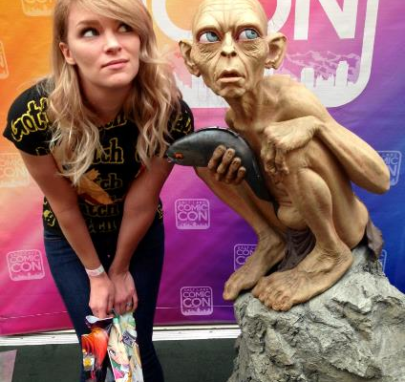
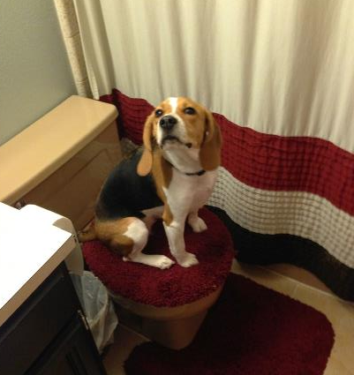
This is my family.
My wife: Elizabeth
My dog: Juniper

Slide 4
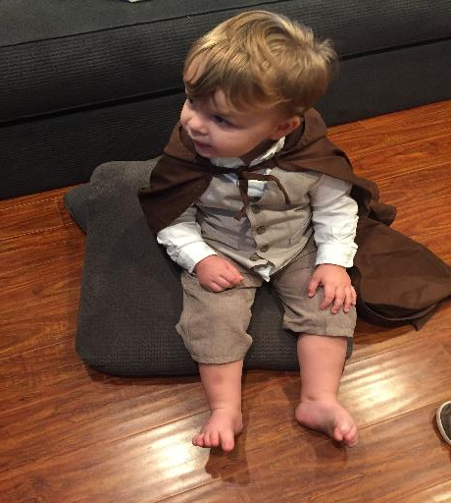
My Son: Thurston

Slide 5
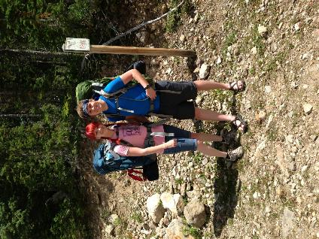
My favorite hobbies
Backpacking with my wife

Slide 6
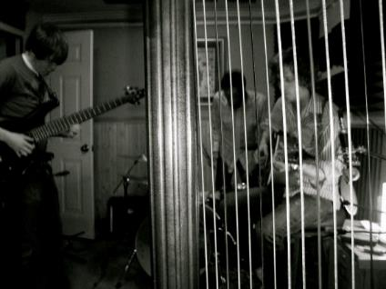
My favorite hobbies
Playing music

Slide 7
My favorite hobbies
Watching a good sci-fi movie.

Slide 8
What About You?
In groups of two to three, introduce yourselves to each other
Tell each other…
your preferred name
where you are from originally
about something fun you did during the break (or something fun you plan to do this summer)
about your favorite hobby

