Slide 1
The zodiac
Presented by
Joshua wooi

Slide 2
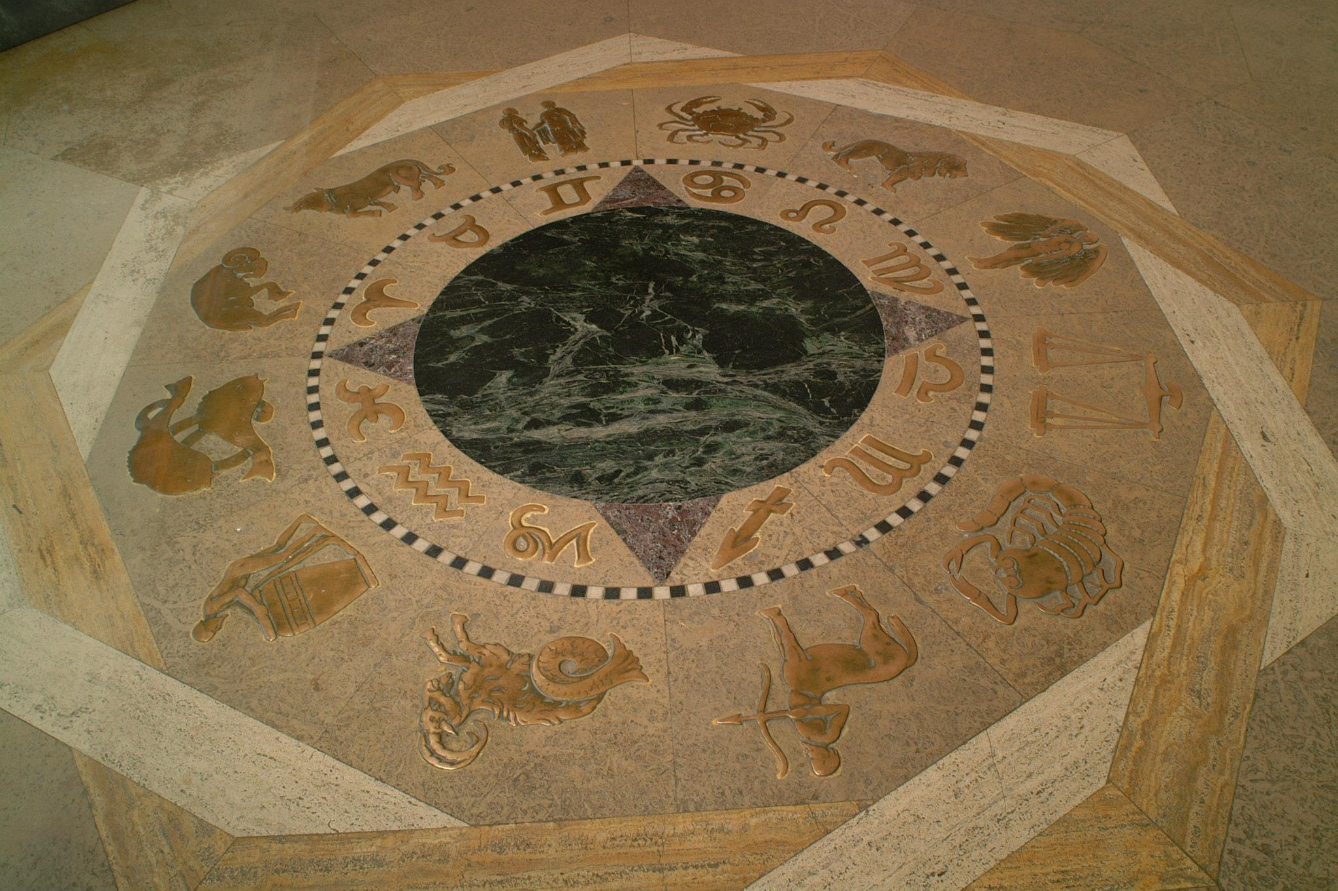
What is the zodiac?

Slide 3
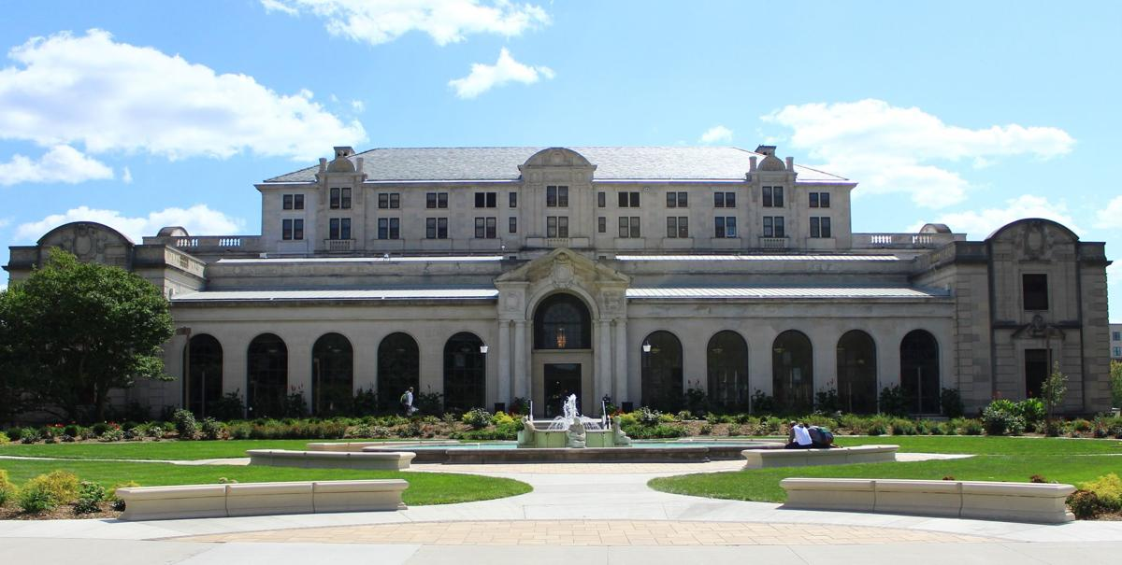
Where is the zodiac?
Memorial Union

Slide 4
Why is the zodiac?
William T. Proudfoot
What was Proudfoot’s original intentions?
1928
How the tradition started?
1929
Why the tradition started?

