Slide 1
The zodiac
Presented by
Joshua wooi

Slide 2
Submitted draft

Slide 3
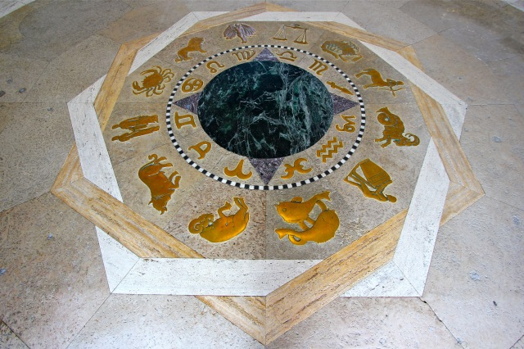
The zodiac

Slide 4
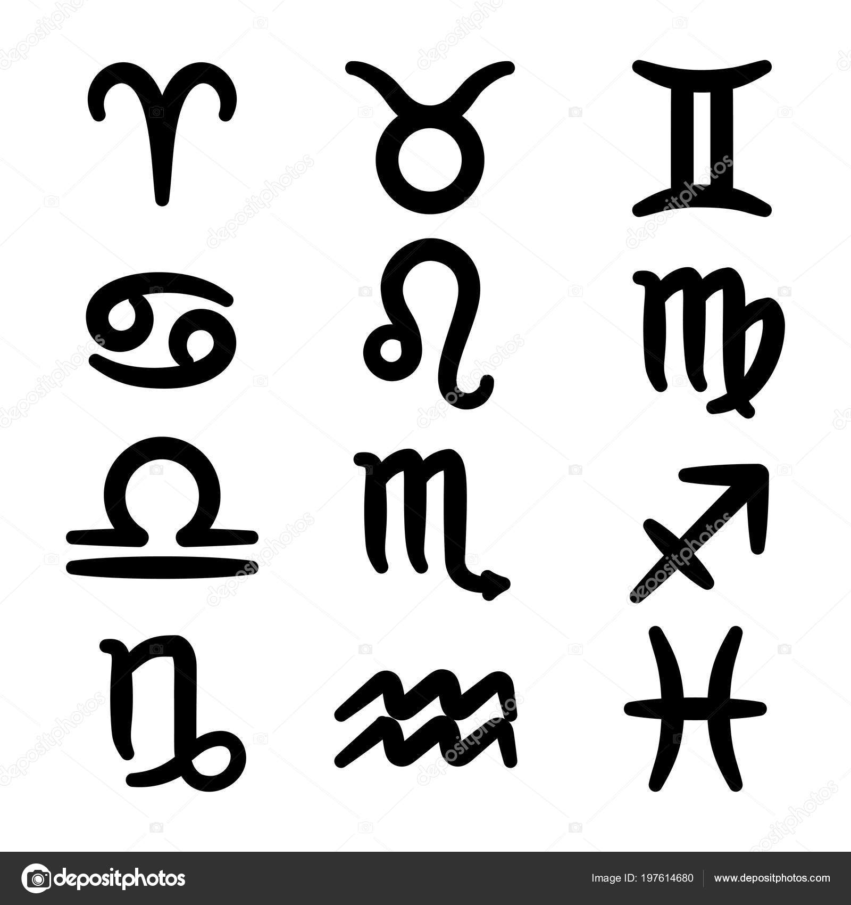
The zodiac

Slide 5
The zodiac

Slide 6
The zodiac

Slide 7
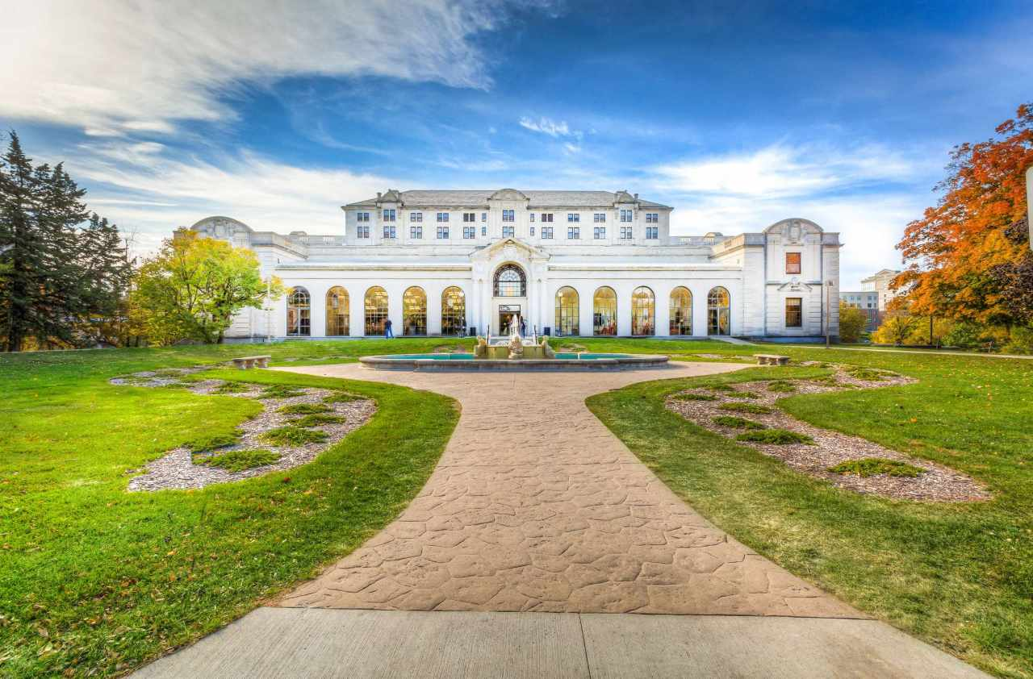
Background (memorial union)

Slide 8
Background (memorial union)

Slide 9
Nearly there…

Slide 10
Informative texts…

