Slide 1
The effect of GDP per capita on happiness
Notes:
When asking people about what would make their lives happier, their first answer is typically “money.” But how accurate is this common prediction? We can find out if this is truly accurate by looking at the opposing perspectives about the effect of GDP per capita on happiness.

Slide 2
While research done by Ed Diener and Robert Biswas-Diener argues that GDP per capita is a reliable indicator of happiness and should simply be supplemented with other measures, research done by Sabine Hossenfelder supports the idea that GDP is entirely ineffective on its own and should not be considered.
Notes:
While research done by Ed Diener and Robert Biswas-Diener argues that GDP per capita is a reliable indicator of happiness and should simply be supplemented with other measures, research done by Sabine Hossenfelder supports the idea that GDP is entirely ineffective on its own and should not be considered.

Slide 3
GDP should be supplemented
Perspective
1
GDP is a reliable indicator of happiness, but there needs to be more accuracy
Notes:
The first perspective will cover is that GDP is a reliable measure of happiness but should be supplemented with other measures to increase how accurate it is.

Slide 4
.82
is the Pearson correlation between income and happiness.
Notes:
So we can see strong correlation between income and happiness--in fact, the Pearson correlation is .82, which about as high of a correlation that can be found in studies of happiness.

Slide 5
GDP is effective
One of the most reliable indicators of happiness
↑ Income → ↑ Life Satisfaction
People who won the lottery or inherited large sums of money were generally happier than those who hadn’t
Notes:
GDP has not been replaced as the best measure of happiness in a nation since it is one of the strongest predictors of life satisfaction in societies. We can further analyze the effect of wealth on happiness by looking at the happiness of those who have received large sums of money. Research has found that as a whole, those who won the lottery were, in general, happier than those who had not. It was also found that those who had inherited a large amount of money exhibited a significant increase in happiness.

Slide 6
“…all the societies with the highest life satisfaction are the wealthy ones...and most of the unhappiest ones are the extremely poor ones.” (Diener, et al. 111)
Notes:
Studies have found that “…all the societies with the highest life satisfaction are the wealthy ones...and most of the unhappiest ones are the extremely poor ones.”

Slide 7
Other factors influence happiness
Some poor nations still report higher happiness than expected
The extremely poor are not depressed, and the rich are not extremely happy
$Happiness= \frac{What we have (attainments)}{What we want (aspirations)}$
Notes:
Although the correlation between GDP and happiness is extremely high, there are still other factors that affect how happy people are, and should supplement the measure of GDP. This is because it has been found that those who are extremely poor tend not to be depressed, and rich people are not extremely happy. Researchers have looked into what other options can combine with GDP in order to measure happiness, for example the happiness formula, which takes into account both money and desire, accounting for GDP but also looking at what people want. Another idea suggests that using money to buy time can lead to happiness, but using money to buy material items will not.

Slide 8
Amish people tend to be more satisfied with their lives
They have comparatively low earnings and avoid many technologies but tend to be happier.
https://www.gettyimages.com/detail/photo/amish-girls-smiling-near-a-corn-field-royalty-free-image/90960434?adppopup=true
Notes:
Here we can see an example. Amish people have relatively low earnings and use far less technology than the average person in modern day society, yet they tend to be quite happy. This is because what brings them happiness is not material belongings, but rather the community and activities they do from day-to-day.

Slide 9
GDP should be eliminated
Perspective
2
Measure happiness on a different scale
Notes:
The second perspective proposes that GDP should be completely replaced by some other more encompassing measure of happiness.

Slide 10
GDP is not effective
Material rewards do not make people happy
Opportunities available to individuals may be a better indicator of happiness
There are other measures of happiness that are more inclusive
Happy Planet Index (HPI)
Notes:
Studies have found that being rich often does not lead to happiness as material rewards do not make people happy. Furthermore, research done by Sabine Hossenfelder, an author affiliated with the Nordic Institute for Theoretical Physics, has found that the number of opportunities an individual has can be a viable measure of happiness. While money does not have much use on its own, it can give us many opportunities to grow and have the freedom to lead a comfortable lifestyle. Finally, the Happy Planet Index, or HPI, has been offered as an alternate measure of happiness.

Slide 11
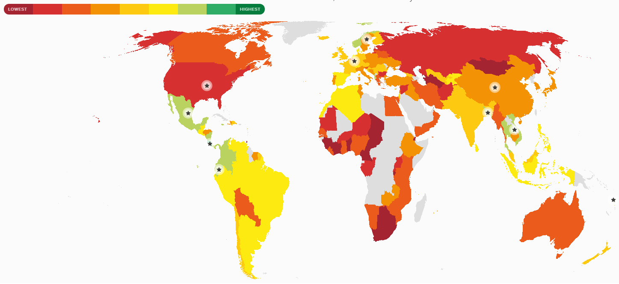
HPI: 20.7
108th of 140
High life expectancy
High wellbeing
1 in 6 Americans live below the poverty line (economic inequality)
4th largest ecological footprint
Happy Planet Index: USA
Notes:
We can see how it measures happiness here. The United States, although it has the highest GDP in the world, is ranked 108th out of 140 countries, with an HPI score of 20.7. This takes into account the high wellbeing and life expectancy of the people, but also uses the economic inequality and extremely large ecological footprint to come to the final calculation.

Slide 12
HPI: 20.7
108th of 140
GDP per capita is a tenth the size of the U.S.
Life expectancy and wellbeing are relatively high
Economic inequality is slightly higher than the U.S.
Ecological footprint is extremely small
HPI: 37.0
10th of 140
Happy Planet Index: Ecuador
Notes:
On the other hand, Ecuador ranks as 10th out of the 140 countries, with an HPI score of 37.0, even though it’s GDP per capita is a tenth the size of the U.S. Its life expectancy and wellbeing are relatively high, economic inequality is slightly higher than the U.S., but ecological footprint is extremely small. This measure of happiness yields very different results than if GDP were to be used.

Slide 13
“…it is not money itself that we desire, it is the possibilities it opens, whether we will eventually use them or not.”
(Hossenfelder 292)
Notes:
Overall, we can see that there are many different ideas on how to measure happiness. Hossenfelder says that “…it is not money itself that we desire, it is the possibilities it opens, whether we will eventually use them or not.”

Slide 14
As of now, GDP is the only measure of happiness that has such a strong correlation with it. Once a new, more accurate measure of happiness is developed, it will be in our best interests to use GDP only as an indicator of economic wealth. Until then, supplementing GDP with other measures of happiness may be our only option.
Notes:
As of now, GDP is the only measure of happiness that has such a strong correlation with it. Once a new, more accurate measure of happiness is developed, it will be in our best interests to use GDP only as an indicator of economic wealth. Until then, supplementing GDP with other measures of happiness may be our only option. It is how seriously we take the happiness of people that is the real question.

Slide 15
References and Credits
Bolger, James Brendan. “Measuring What Matters: Moving Beyond GDP.” Interaction Voice, May 2019, pp. 14–16.
Csikszentmihalyi, Mihaly. “If We Are So Rich, Why Aren't We Happy?” Pursuing Happiness: a Bedford Spotlight Reader, by Matthew Parfitt and Dawn Skorczewski, Bedford/St. Martin's, Macmillan Learning, 2020, pp. 84–98.
Diener, Ed, and Robert Biswas-Diener. “Can Money Buy Happiness?” Pursuing Happiness: a Bedford Spotlight Reader, by Matthew Parfitt and Dawn Skorczewski, Bedford/St. Martin's, Macmillan Learning, 2020, pp. 104–117.
“Happy Planet Index.” Happy Planet Index, New Economics Foundation, happyplanetindex.org/.
Hershfield, Hal E., et al. “People Who Choose Time Over Money Are Happier.” Pursuing Happiness: a Bedford Spotlight Reader, by Matthew Parfitt and Dawn Skorczewski, Bedford/St. Martin's, Macmillan Learning, 2020, pp. 119–137.
Hossenfelder, Sabine. “On the Problem of Measuring Happiness.” Interdisciplinary Description of Complex Systems, vol. 54, no. 10, 24 Mar. 2013, pp. 290–301., doi: 10.7906/indecs.11.3.2.

