Slide 1
Should Internet Cookies Be Further Regulated by the Government?
Research Presentation by Kaitlin Burdick

Slide 2
Overview
Background
Arguments For the Regulation of Cookies
Arguments Against the Regulation of Cookies
Conclusion
Questions

Slide 3
Background Information
Why is this important?
In 2013 74.4% of Americans used the internet (File and Ryan 2).
What are cookies?
Small text files stored on a user’s computer (Gervais).
Why were they created?
To fix the inconvenient memory problem of the World Wide Web (Schwartz).
What information do cookies store?
Non-identifying information.
What are the current regulations on the usage of cookies?
Informed usage of cookies and ability for user to control cookies (Hoofnagle et al.).

Slide 4
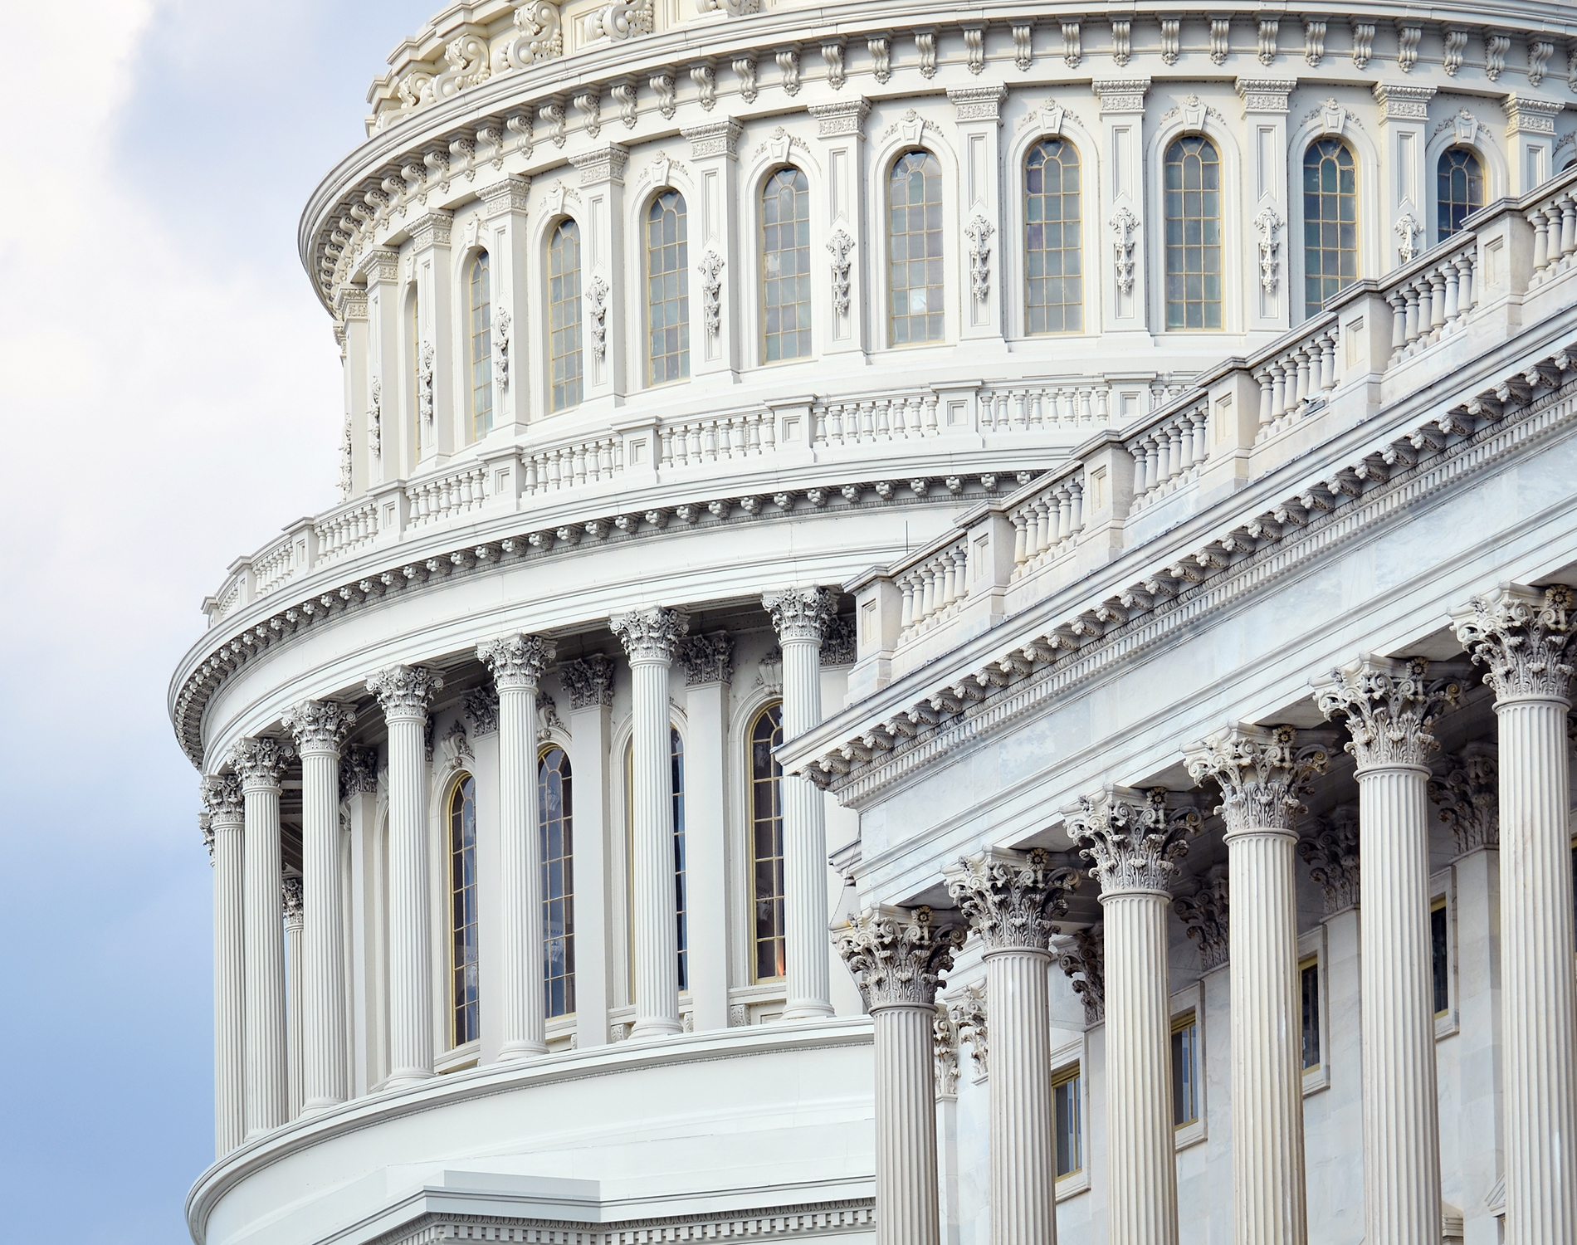
Argument For Increased Government Regulation
Regulations were made in 2010
Invasion of Privacy
Advanced “respawning” cookies
Third-party data collection

Slide 5
Advanced Cookies
Flash cookies “respawn” upon deletion by the user.
Often hard to detect or find on a user’s computer.
Loophole in current regulations.

Slide 6
Third-Party Data Collection
Tracking over many websites by outside companies
Information is sold
Often can reveal sensitive information
Strauss, Valerie. “The Astonishing Amount of Data Being Collect About Your Children”. The Washington Post. 12 Nov. 2015. Web. 28 Apr. 2016.

Slide 7
Arguments Against Increased Government Regulation
Specialization of advertisements
Expected services and applications would be lost
Free market argument

Slide 8
Specialization of Advertisements
Allows ads suited to user.
Ads would become flashier

Slide 9
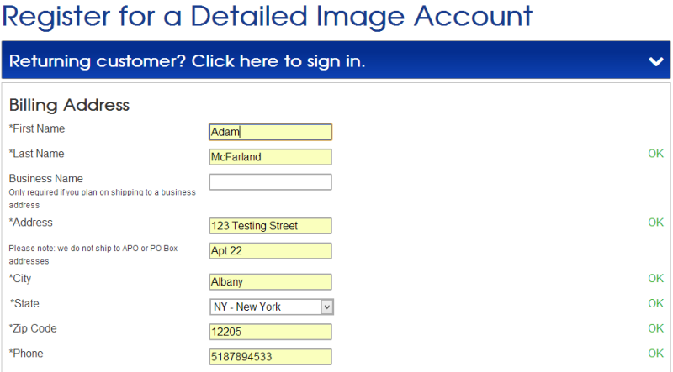
Lost Expectations
Autofill
Loss of Virtual Shopping Carts
“If there is no information collected, it would be like a constant exchange with an amnesiac,” – David Berkowitz (Learmonth).
McFarland, Adam. 29 May 2013. Web. 7 April 2016.

Slide 10
Free Market Argument
Advertisement companies believe consumers are not capable of making informed decision about cookies.
Believe that government regulation is “paternalistic” (Hoofnagle et al.).

Slide 11
Arguments For: - Privacy - “Respawning” Cookies - Third-Party Cookies
Conclusion
Important to understand the background and both sides of an argument before coming to a conclusion.
Arguments Against:
-Specialization of Advertisements
- Lost Expectations
- Free Market Argument

Slide 12
Questions?

Slide 13
Works Cited
File, Thom and Camille Ryan. “Computer and Internet Use in the United States: 2013”. United State Census Bureau (2014): 1-16. Web. 30 Mar. 2016.
Gervais, Norman. “Governmental internet information collection: Cookies placing personal privacy at risk.” Bulletin of the American Society for Information Science and Technology 40.2 (2014): 27-31. Web. 27 Mar. 2016.
Hoofnagle, Chris Jay, Ashkan Soltani, Nathaniel Good, Dietrich J. Wambach, and Mika D. Ayenson. “Behavioral Advertising: The Offer You Cannot Refuse.” Harvard Law and Policy Review 6.2 (2012): 273-296. Web. 26 Mar. 2016.
Learmonth, Michael. “Tracking makes life easier for consumers.” Advertising Age 80.25 (2009). Web. 27 Mar. 2016.
Schwartz, John. “Giving the Web a Memory Cost Its Users Privacy”. New York Times; 4 Sep. 2001. Web. 31 Mar. 2016.
McFarland, Adam. 29 May 2013. Web. 7 April 2016.
Strauss, Valerie. “The Astonishing Amount of Data Being Collect About Your Children”. The Washington Post. 12 Nov. 2015. Web. 28 Apr. 2016.

